Slide 1

RUBEN ROBY COMPUTER SCIENCE DEPT.
CUSTOMER
FEEDBACK
SYSTEM
ROLL NUMBER: 64
17/07/2024

Slide 2
INTRODUCTION
"Developing a system for collecting and managing customer feedback, including surveys and rating." is the problem statement.
Our objective was to design and make a feedback system which will store the feedbacks but also allow to review it later by the customer.
THE CUSTOMER FEEDBACK SYSTEM IS DESIGNED TO ALLOW CUSTOMERS TO PROVIDE FEEDBACK ON A SERVICE OR PRODUCT. IT PROVIDES FUNCTIONALITY TO COLLECT, STORE, AND DISPLAY CUSTOMER FEEDBACK, INCLUDING RATINGS AND COMMENTS.

Slide 3
System requirement
Processor (CPU):
Any modern processor should suffice, would handle the computational demands of this project well.
Memory (RAM):
The amount of memory is more than sufficient for processing typical data inputs and outputs in this type of application.
Operating System:
Windows, macOS, or Linux.

Slide 4
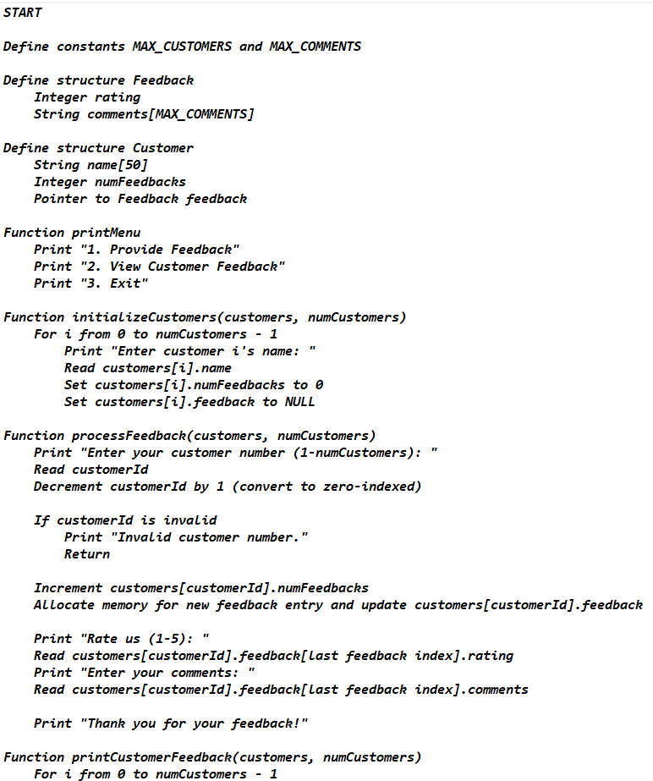
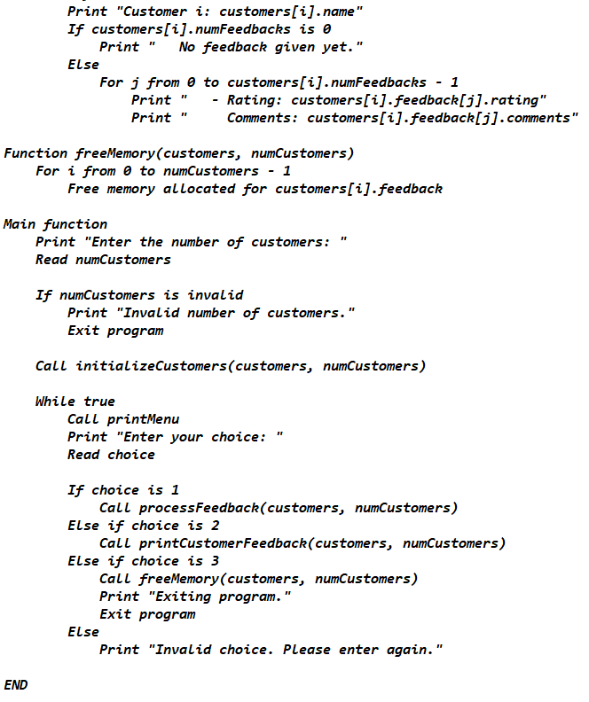
DEVELOPMENT

Slide 5
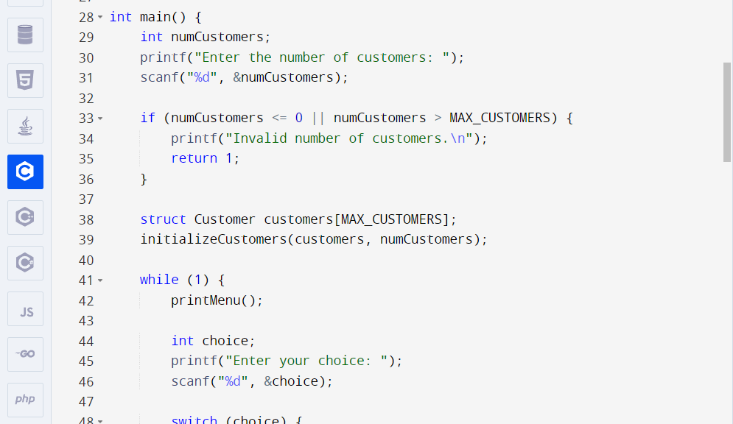
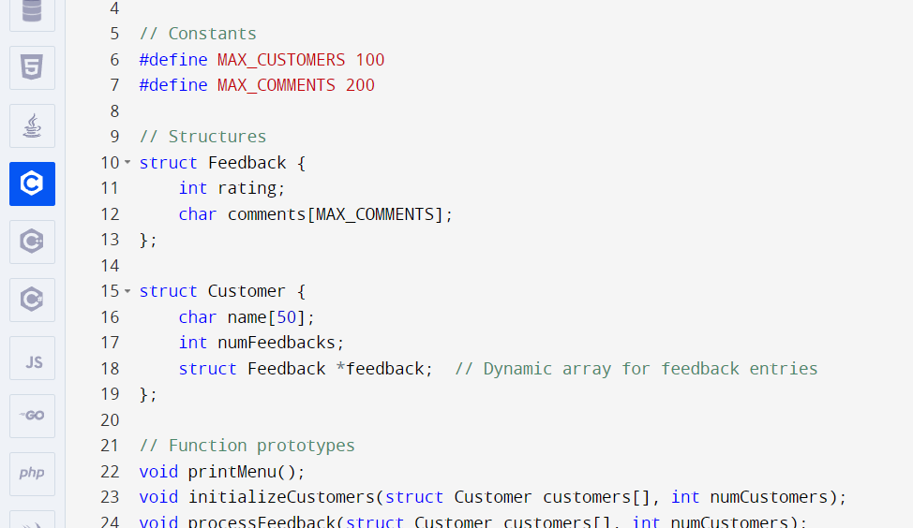
PROJECT CODE

Slide 6
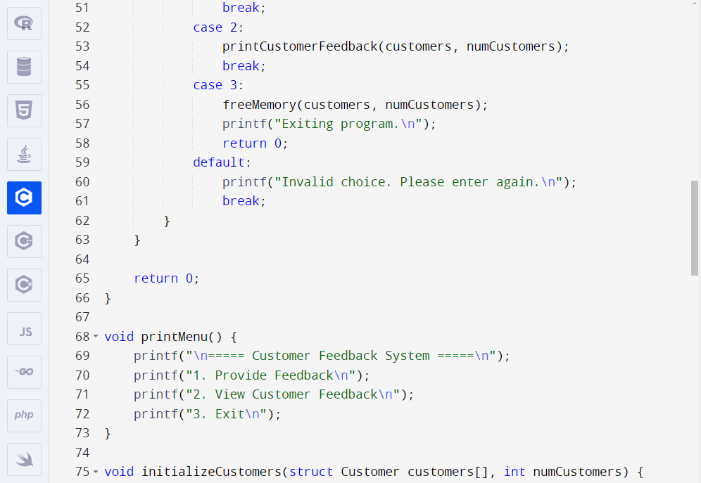
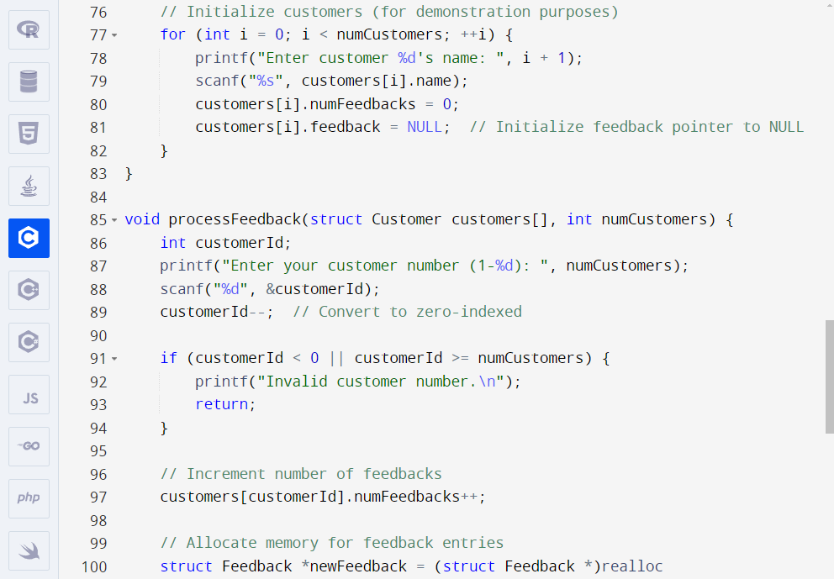

Slide 7
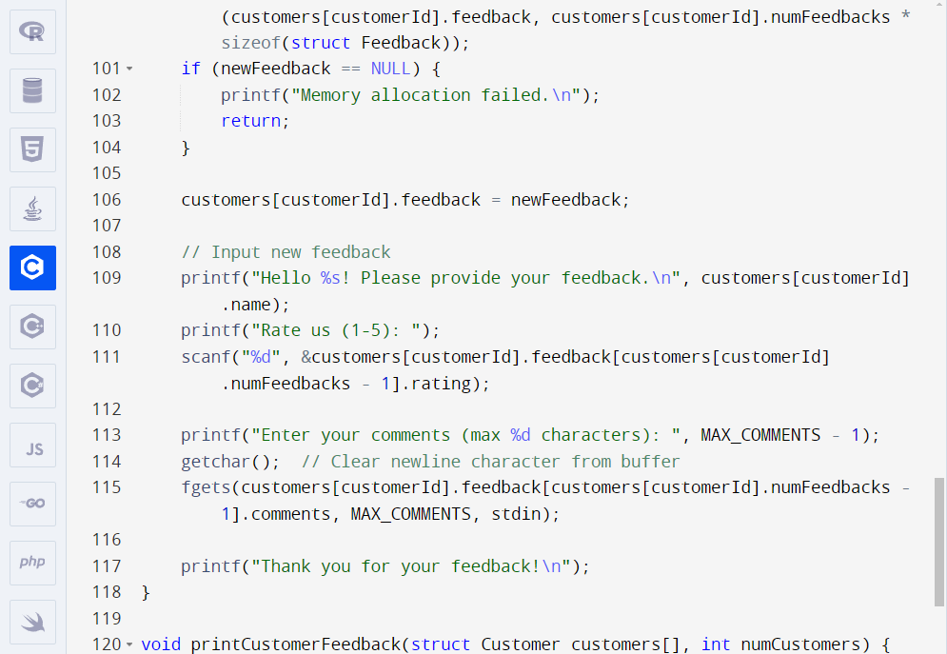
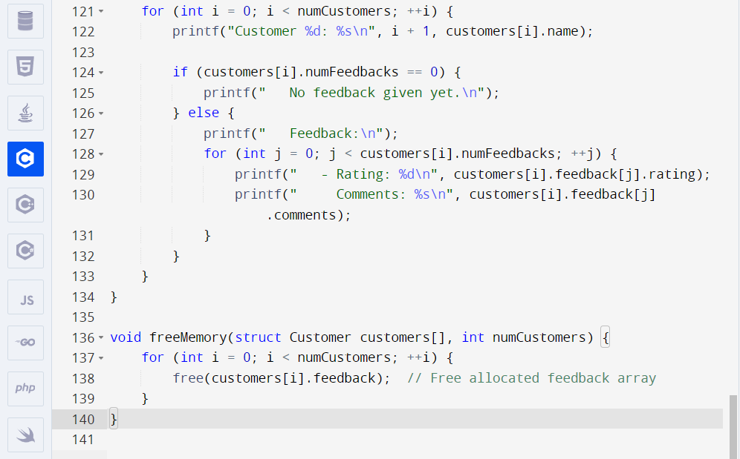

Slide 8
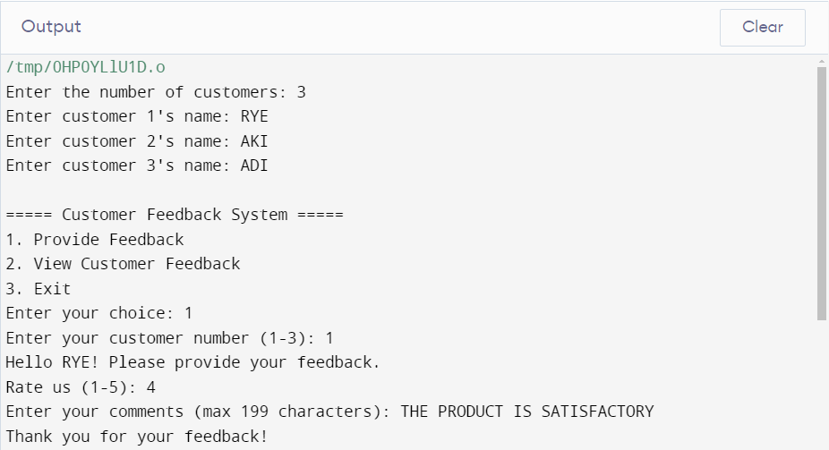
OUTPUT

Slide 9
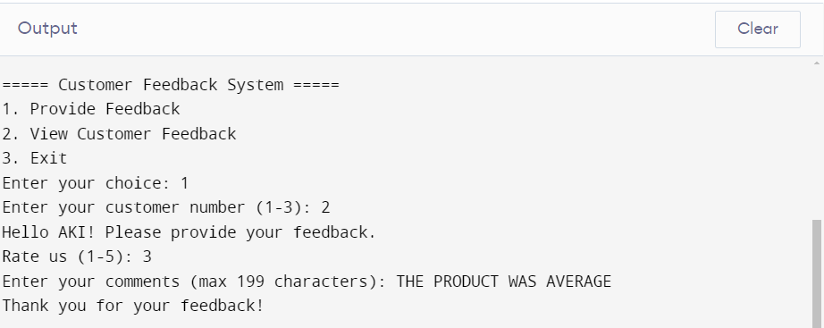
OUTPUT

Slide 10
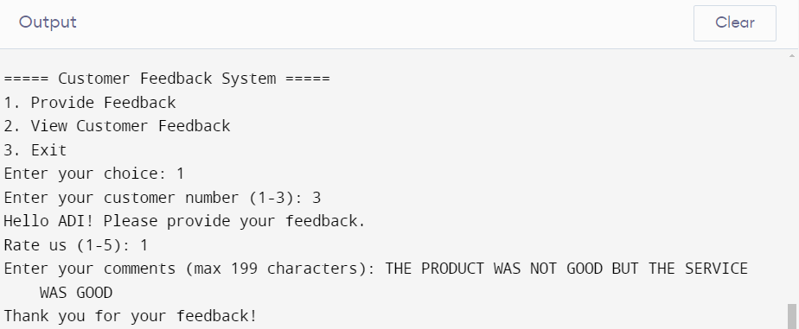
OUTPUT

Slide 11
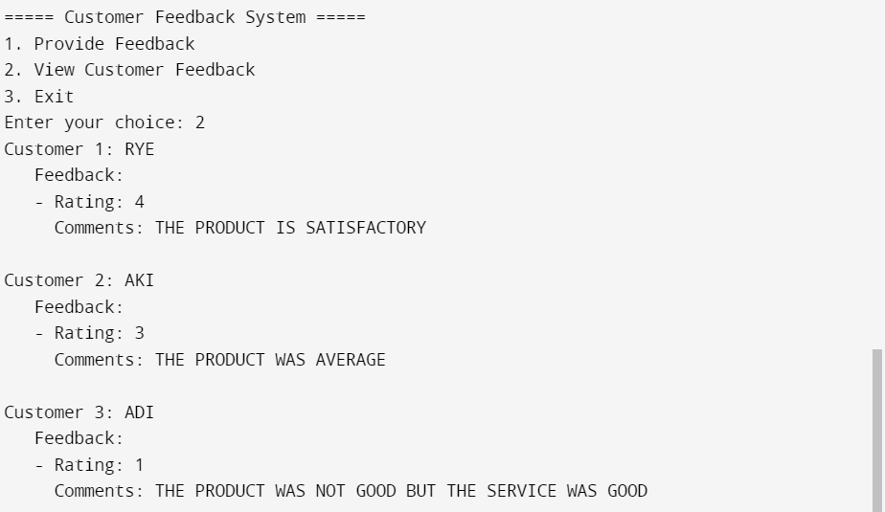
OUTPUT

Slide 12
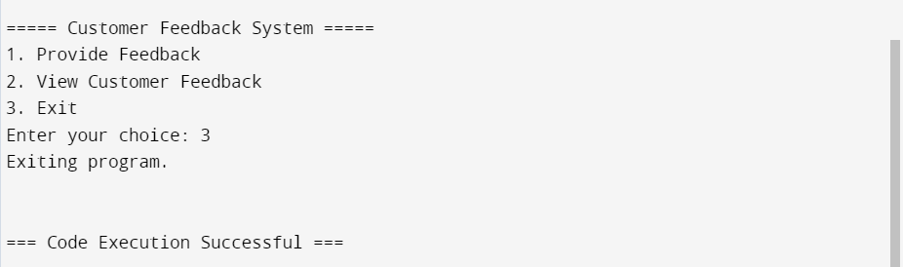
OUTPUT

Slide 13
CONCLUSION
This program is a customer feedback system in C. It allows customers to provide feedback, view feedback, and handles dynamic memory allocation for feedback entries. Here's a brief explanation of each function and the main logic:
Main Program Flow:
Initialize customers based on user input.
Continuously display a menu and handle user choices:
Provide Feedback
View Feedback
Exit and free memory

Slide 14
FUTURE ENCHANCEMENTS
1.GRAPHICAL USER INTERFACE: THE USER INTERFACE CAN BE UPDATED ABD TO THE LIKINGS OF THE CUSTOMER.
2. DATABASE INCREMENT: THE INCREASE IN DATABASE CAN HELP IN THE STORAGE OF MANY MORE FEEDBACKS.
3.ADVANCED SEARCHING AND STORAGE: WITH THE INCREASE OF USER FRIENDLY DESINGS IT WILL ALSO HELP GREATLY IF THE USER SIDE OF REVIEWING IS ALSO DESIGNED TO THEIR LIKINGS
4.DETECTION OF SPAM: IN A AGE OF SPAMS AND RANDOM MESSSAGES IT WILL BE GREAT IF THE SYSTEM HAD A IN BUILT PROGRAM TO DETECT SPAMS
5. ERROR HANDELLING: AUTO CORRECTION AND ERROR DETECTION WITH T5HE PROMISE OF IMMEDIATE REVISION OF THE ERROR WOULD ALSO BE GREATEFULL.

Slide 15
THANK YOU
RUBEN ROBY
CSE B, 64

